Slide 1
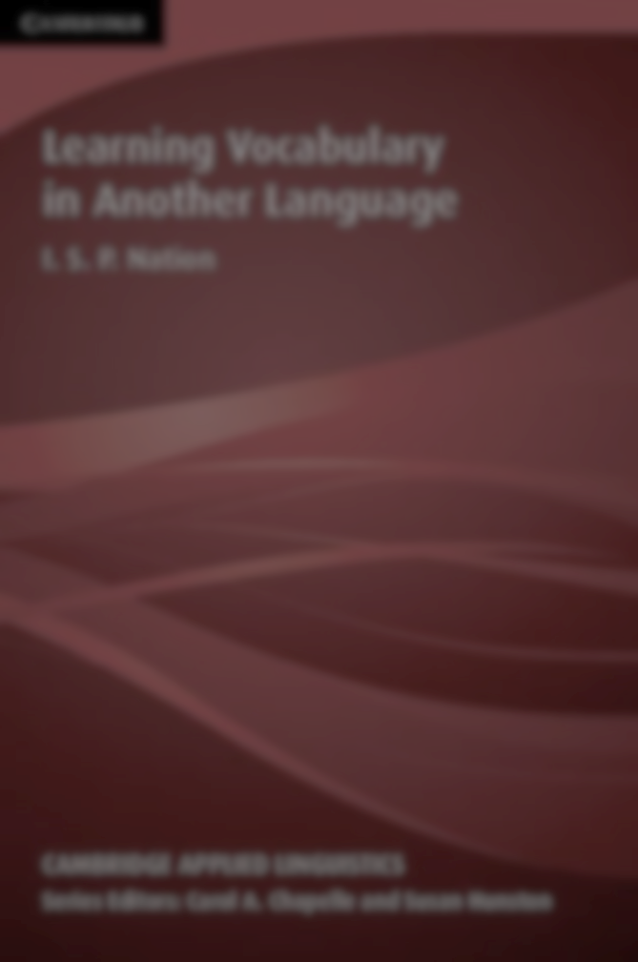
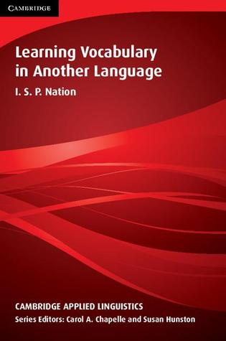
Overview of the Book: Learning Vocabulary in Another Language by I.S.P. Nation
Name:
Course Title:
Date:
Instructor:

Slide 2
Why this topic was selected
The topic was selected as it was informative
It was also interesting to read which influenced my decision
Moreover, the topic provided an interactive platform in which basic life skills are learnt that are helpful in future career

Slide 3
Why this book was particularly selected
The book was selected due to its unique presentation which is easy to comprehend
It allow the reader to identify the major theme and ideas thus helping in easier comprehensive
It also comprise of detailed and theories about Learning Vocabulary in Another Language.
The skills book has a unique presentation method that allows the reader to easily comprehend the important topic
The author make it easy for teachers and learners to learn about the easiest method that a reader can use to learn another language
Most importantly, the vocabulary learning strategies presented in the book are easy to follow and implement.

Slide 4
overview of the book
The book present an overview of the various vocabulary learning strategies used by a teacher or a learner to comprehend a new language.
It provide pedagogical suggestions on the techniques that can be used in learning new language
The techniques are backed up with references, case studies, teaching experiences as well as experimental research making it easy for the leader to comprehend.
The book describes systematically the important vocabularies that the leader need to understand in order to become effective in learning the new language.
The book has a guideline in which the tutor has to follow in enabling his or her learner to get the best out of the learning lessons.

Slide 5
About the book and its major themes
The book major theme is to educate those willing to learn new language the easiest methods to do so
It contain a systemic guideline in which a learner or a teacher can use in order to easily comprehend and appreciate the new language
The book is basically the most outstanding book which act as a reference and guideline towards achieving linguistic

Slide 6
Uniqueness of the book
The book is unique in numerous ways
Firstly, it provide a chronological guideline in which those willing to learn a new language need to follow (Nation, 2013).
The method proposed are unique and outstanding
They are supported by numerous evidence based techniques that are justified by a clear reference to case study or a teaching experience.
&
What stood out most in the book

Slide 7
What learnt from the book and relationship my teachings
There are many teachings learnt from the book
The most relevant one is a guideline towards learning new language especially when it comes to vocabularies
The books teaching relate well with my teachings as it provide an overview on the ways I can handle a class of learners
Most significantly, it offer guidelines in the methods that are useful in learning new language

Slide 8
Relationship Between The Book And Learning Broadly And Topics Learnt
The presentation of the book offer a good relationship between it content and that of the topic learnt.
Its content create a better linguistic connection between topics and theories learnt in the course
I find the book to be relevant to me as a teacher or an aspiring teacher as it offer a pathway to easier method to learn and teach a new language.
I also have a strong feeling that this book is relevant to educators working in an urban setting •
I therefore recommend it to all peers in this class or any other linguistic class across the globe as it offer clear and simple guideline towards leaning a new language.

Slide 9

We can conclude by saying that all the threats are interconnected to one another and should therefore be solved based on their priorities.
Thank You

Slide 10

References
Nation, I. S. (2013). Learning vocabulary in another language Google eBook. Cambridge University Press.

